Slide 1

How does FinPricing Manage Market Data?
FinPricing

Slide 2
Market Data
Market data is a broad term for trade-related data. It encompasses a range of information such as price, bid/ask quotes and market volume for financial instruments. Financial firms, traders and investors require such data to execute trades. Market data is generated in real time, which means that it can be used to make quick but informed trading decisions. In the meantime, historical market data are a crucial part of technical analysis, and can be used to project pricing trends and to calculate risk.

Slide 3
Market Data
Trading venues provide reports on various assets and financial instruments, which are then distributed to traders and firms. Market data is available across thousands of global markets, including stocks, indices, fixed-income, interest rates, derivatives, forex and commodities. The aim of using market data is to get as much information about the asset you are planning to trade, in order to calculate risk and the impact of live news releases.

Slide 4

Summary
Market Data
How to load/modify market data associated with a trade in FinPricing?
How to load/modify market data manually in FinPricing?
How to local bulk market data in FinPricing?

Slide 5
Market Data
How to load/modify market data associated with a trade?
In finance, market data is associated with investment instruments or trades.
After creating a new trade or loading an existing trade (see details at http://www.finpricing.com/faq/tradeLifecycle.html), click the Market Data tab that is beside the Trade Detail tab. Then the user can either click the New button to input new market data or the Load button to extract the existing market data.
If the user chooses to input new market data by specifying the Valuation Date and then clicking the New button, the system knows what kind of market data needed for this trade and thus generates market data templates displayed in the main window.

Slide 6
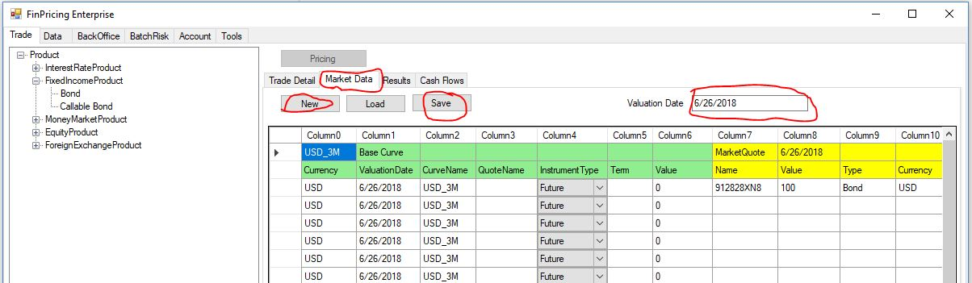
Market Data
How to load/modify market data associated with a trade? (Cont'd)
After filling the market data and then clicking the Save button, an OK windows pops up if all data are in correct formats and value types. That means the new market data are saved into the system and ready to use.
Please note that FinPricing provides some market data to users. However, a user feels free to modify or provide their own market data. Those new or modified market data will be private to the user.

Slide 7
Market Data
How to load/modify market data associated with a trade? (Cont'd)
If user chooses to load existing market data by inputting a Valuation Date (say, 2/8/2018) and then clicking the Load button, a selection form appears in the main window. The user can select a date from pull-down menus. If all available dates are not what he wants, just select NA (not available). Then click the Extract button at the right of the row.
Note: the valuation date and the market data date are allowed to be different as sometimes a user conducts what-if analysis at a start-of-day (SOD), when the new market data are still not available. In that case, the user can use yesterday's data.

Slide 8
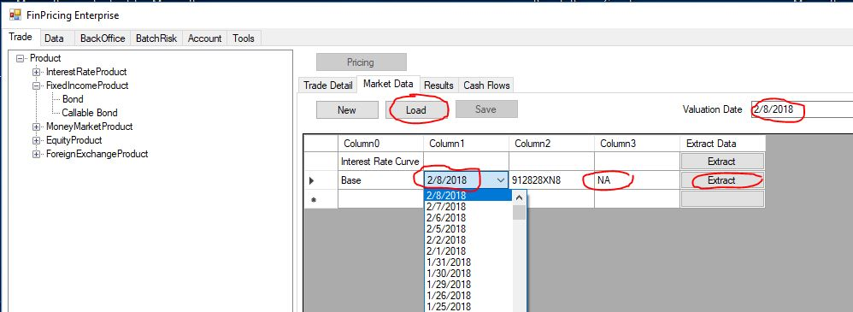
Market Data
How to load/modify market data associated with a trade? (Cont'd)

Slide 9
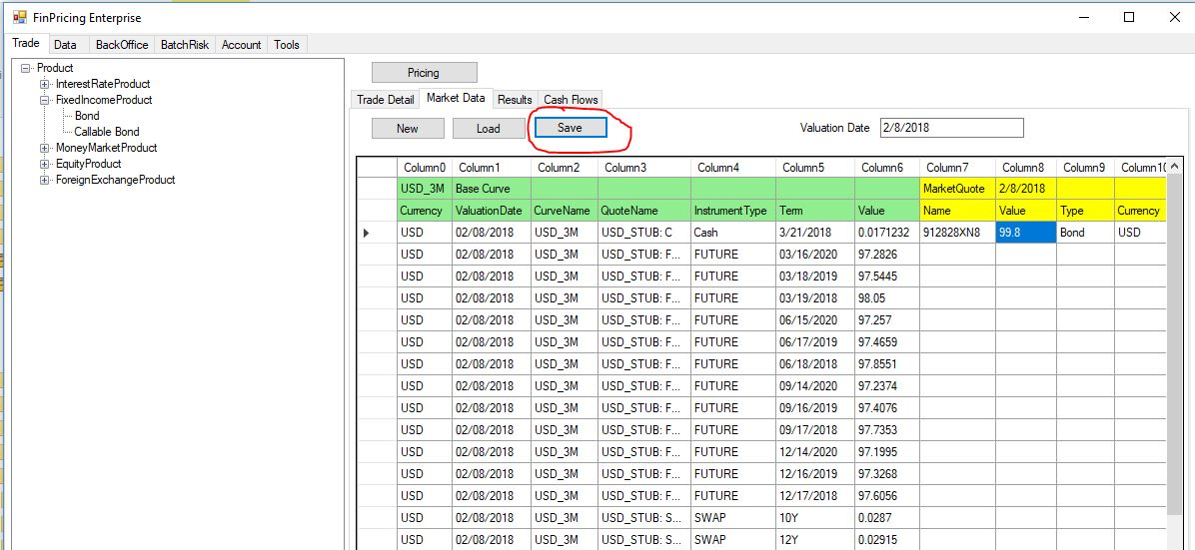
Market Data
How to load/modify market data associated with a trade? (Cont'd)
The market data on 2/8/2018 are loaded in the main window. Again the user can modify and save the market data.

Slide 10
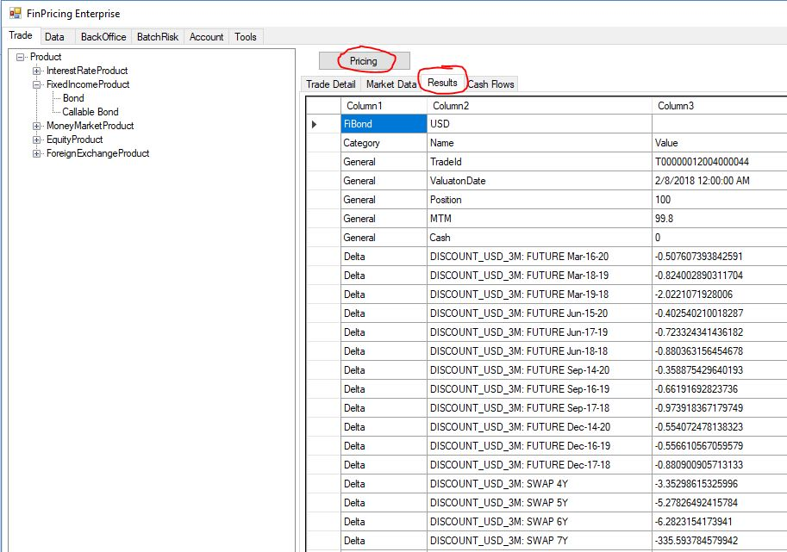
Market Data
How to load/modify market data associated with a trade? (Cont'd)
After either new market data saved or existing market data loaded, the user can click the Pricing button. The calculation results will be presented in the Results tab.

Slide 11
Market Data
How to load/modify market data associated with a trade? (Cont'd)
Sometimes, bond prices are available (quoted) in the market. If the bond price is provided, FinPricing will match the model price to the market price by calibrating a credit spread that reflects credit risk and liquidity risk.
If the market bond price is not given, FinPricing will compute the model price only based on the discount and/or forecast curves provided.
FinPricing calculates sensitivities or Greeks based on market observable and liquid instruments, such as LIBOR rates, Eurodollar futures, and swap rates. This is the best market practice and convention as hedge and risk analysis are based on market observables. Most trading systems in the market compute Greeks relying on zero-rates, which is an easy way for convenience.
To compute Greeks on market instruments, system/model needs to shock each instrument and then reconstruct curve one by one. The calculation is much more complex and time-consuming. But trickery cannot be used to gain advantage.

Slide 12
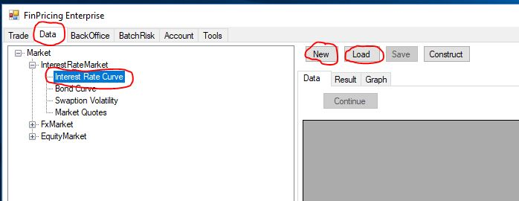
Market Data
How to load/modify market data manually?
Click the Data tab at the top-left corner of the application. Then, expend Market -> particular market (e.g., Interest Rate Market) and select a market data set (e.g., Interest Rate Curve) .
After that, you can either click the Load button to load an existing market data set for review/modification or the New button to generate new market data.

Slide 13
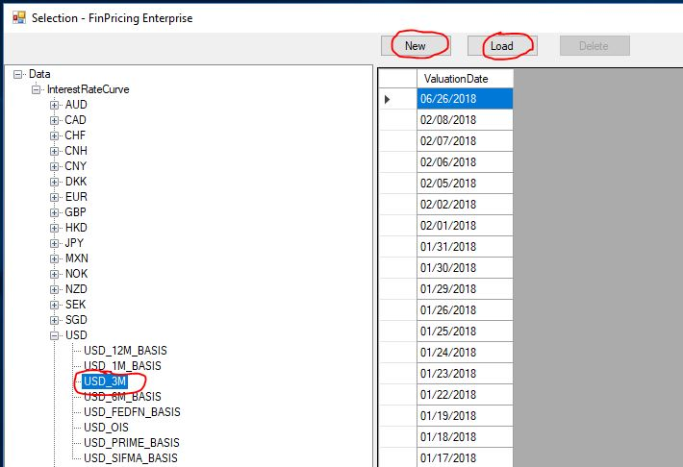
Market Data
How to load/modify market data manually? (Cont'd)
If you click the Load button, a selection window pops up. Expend Data -> InterestRateCurve -> Currency (e.g., USD) and select a curve (e.g., USD_3M). The list of the available market dates of USD_3M is displayed in the main windows

Slide 14
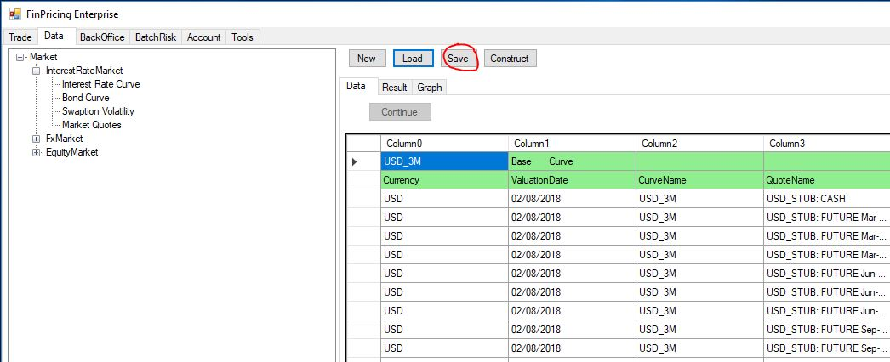
Market Data
How to load/modify market data manually? (Cont'd)
Select a date and then click the Load button. The market data of that valuation date are displayed in the main windows. You can modify the data and click the Save button to save all the changes.

Slide 15
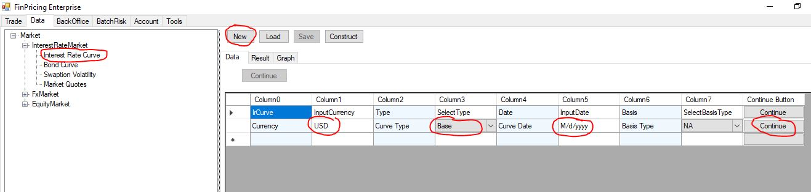
Market Data
How to load/modify market data manually? (Cont'd)
Or if you click the New button, a selection template form is displayed in the main windows.
Input Currency and Curve Data, and select Curve Type and Basis Type (if applicable). Then click Continue button at the end of each row.

Slide 16
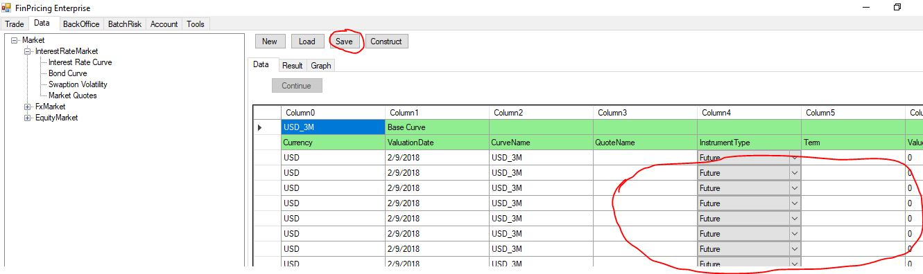
Market Data
How to load/modify market data manually? (Cont'd)
A new market data template is shown in the main window. Fill all fields and click the Save button. The new market data are generated.

Slide 17
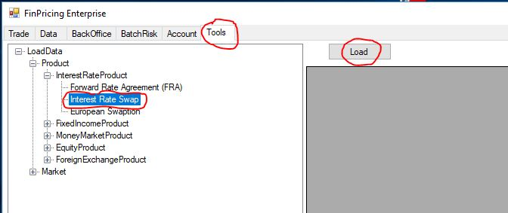
Market Data
How to local bulk market data?
Click the Tool tab at the top-left corner of the application. Next, expend Product -> InterestRateProduct (for example). Then, select the Interest Rate Swap.

Slide 18
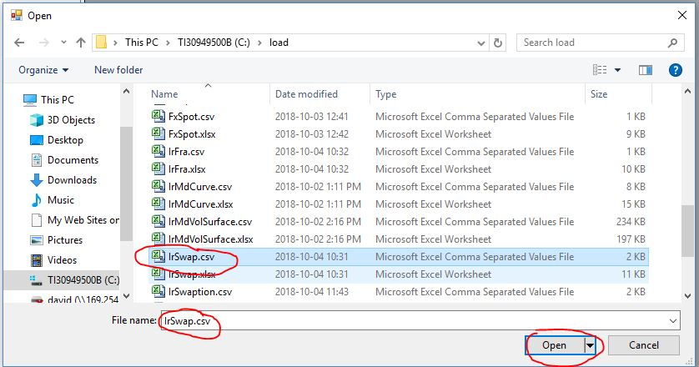
Market Data
How to local bulk market data? (Cont'd)
Next, click the Load button. A window pops up allowing users to browse the local folders and select files.
After selecting a bulk trade file that is in csv format, click the Open button.

Slide 19
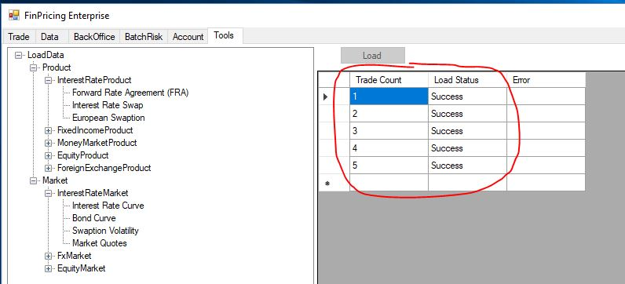
Market Data
How to local bulk market data? (Cont'd)
FinPricing starts to load all the trades defined in the file. Finally a summary table is displayed in the main window telling you how many trades are successfully loaded and how many of them fail.

Slide 20
Thank You
You can find more details at
https://finpricing.com/faq/manageData.html
https://finpricing.com/faq/loadData.html
https://finpricing.com/faq/bulkLoad.html

