Slide 1
How to Download and Install Derivatives Trading System?
FinPricing

Slide 2
Download and Installation
FinPricing is a capital market software system and solution that covers the entire transaction lifecycle for derivatives, securities and cash instruments, from trade capture, data service, performance monitoring and risk management, through to back office processing and reporting

Slide 3
Download and Installation
Summary
How to Download and Install FinPricing?
How to Launch FinPricing?

Slide 4
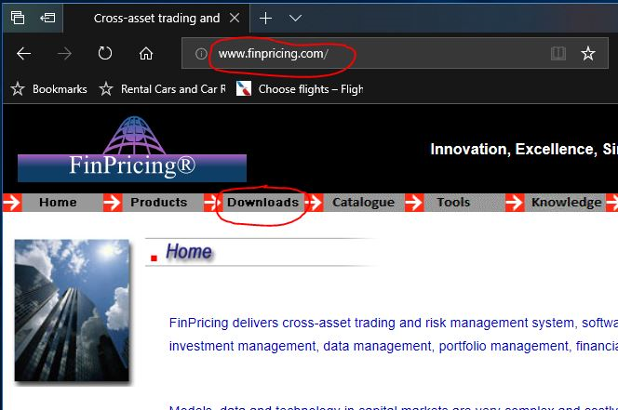
Download and Installation
How to Download and Install FinPricing?
Go to http://www.finpricing.com/ and click the Download button on the menu bar.

Slide 5
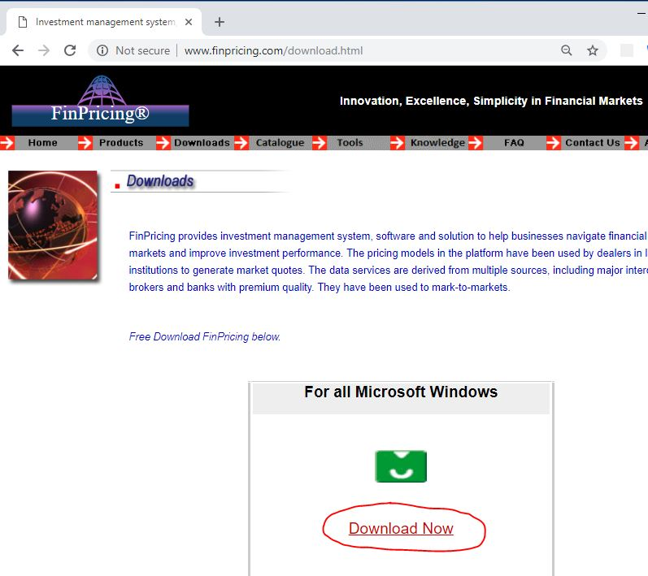
Download and Installation
How to Download and Install FinPricing? (cont’d)
It brings you to http://www.finpricing.com/download.html. Then click the Download Now link.

Slide 6
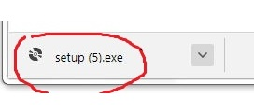
Download and Installation
How to Download and Install FinPricing? (cont’d)
The installer file "setup.exe" appears, most probably at the bottom left corner of your web browser.
Click to open the "setup.exe" and installation starts

Slide 7
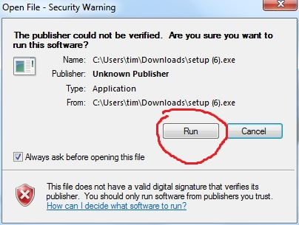
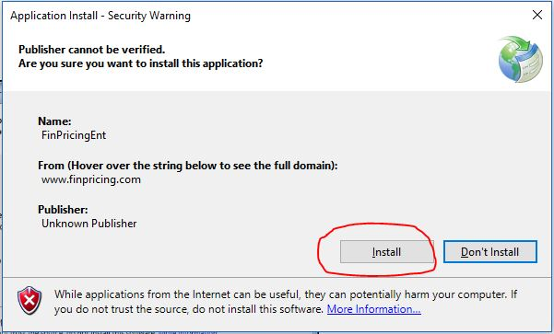
Download and Installation
How to Download and Install FinPricing? (cont’d)
Follow the on-screen instruction to finish.
Note that some anti-virus software or firewall or Windows defender may block the download or installation. Please select Download Anyway or Install Anyway

Slide 8
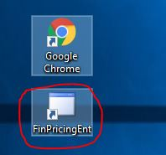
Download and Installation
How to Launch FinPricing?
After successful installation, you can find the application shortcut on your desktop

Slide 9
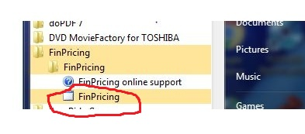
Download and Installation
How to Launch FinPricing? (Cont’d)
Or find the application in ALL Programs by clicking Start -> All Programs -> FinPricing

Slide 10
Download and Installation
How to Launch FinPricing? (Cont’d)
Click either of them to launch the application.
Register first by clicking the SIGNUP button and then login with your email and password.

Slide 11
Thank You
You can find more details at
https://finpricing.com/faq/install.html

